Slide 1


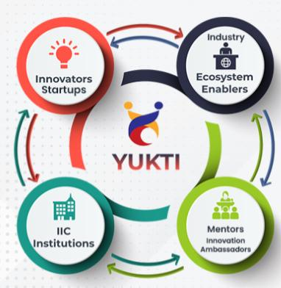
Intra Institutional Innovation Competition YUKTI-2026
Title: ML-Based Cervical Cancer Risk Prediction
Theme:PrototypeStage/ProductsDeveloped
PS Category- Software/Hardware:Software
TeamName(Registeredon portal):CerviGuard

Slide 2
IDEA TITLE
Proposed Solution (Describe your Idea/Solution/Prototype)
The proposed solution is a web-based machine learning application that predicts cervical cancer risk. It takes user health and lifestyle data through an online form and processes it using a trained ML model. The system analyzes risk factors such as age, sexual history, smoking habits, contraceptive use, and STDs. Based on this input, it generates a probability score and categorizes the user into low, medium, or high-risk groups. This tool aims to support early awareness and preventive healthcare.

Slide 3
TECHNICAL APPROACH
The system is developed using Python and Flask for the web interface. A machine learning model is trained using a dataset of cervical cancer risk factors. Missing values are handled using an imputer. The trained model and imputer are saved using Joblib. User inputs are collected through an HTML form, processed using NumPy, and passed to the model for prediction. The output is displayed on the web page with a risk probability.

Slide 4
FEASIBILITY AND VIABILITY
The project is technically feasible as it uses open-source tools like Python, Flask, and Scikit-learn. It can run on standard computers without high hardware requirements. The dataset and model are lightweight, making deployment easy. Maintenance is simple, and the system can be upgraded with new data. The solution is viable for educational, research, and preliminary health screening purposes.

Slide 5
IMPACT AND BENEFITS
This system helps in early detection of cervical cancer risk, enabling timely medical consultation. It increases health awareness among users, especially women in underserved areas. The tool reduces dependency on expensive diagnostic tests for preliminary screening. It supports doctors and healthcare workers by providing quick risk assessments. Overall, it promotes preventive healthcare and improves decision-making.

Slide 6
RESEARCH AND REFERENCES
The project is based on publicly available cervical cancer datasets and machine learning techniques. It uses concepts from data preprocessing, classification algorithms, and medical risk prediction. References include online ML tutorials, Flask documentation, and healthcare research papers on cervical cancer risk factors. Dataset sources such as UCI Machine Learning Repository and standard medical studies were used for training and validation.

